Slide 1


Name: Gopikrishnan Harilal Mini
SkillsBuild Email ID: gopikrishnan_harilalmini@srmap.edu.in
College Name: SRM UNIVERSITY AP, AMARAVATI
College State: ANDHRA PRADESH
Internship Domain : Artificial Intelligence and Machine Learning
Internship Start Date and End Date: 3rd June 2024 – 11th July 2024

Slide 2
Project title :Employee Burnout predictor
Employee burnout is a serious issue in today's fast-paced work environment, and creating a predictor for it can be a game-changer. As a college student studying computer science, I think using machine learning to predict burnout could help companies identify employees at risk and take action before it's too late. By analyzing factors like job satisfaction, work-life balance, social support at work, and access to mental health resources, we can train a model to spot early signs of burnout. This proactive approach could improve employee well-being, boost productivity, and reduce turnover rates. It's exciting to think about how technology can be used to make a real difference in people's lives and create healthier workplaces.

Slide 3
AGENDA :
The project aims to predict employee burnout using logical regression, helping HR teams identify at-risk employees and provide targeted support. It involves collecting and preparing data from various sources, followed by an analysis to uncover initial insights. Logical regression is chosen for its effectiveness in classification tasks. The model is trained, evaluated, and fine-tuned for accuracy. The results are analyzed to identify key predictors of burnout, integrated into HR systems for real-time predictions, and displayed on dashboards. Ethical considerations ensure fairness, and the insights guide HR strategies, manager actions, and organizational policies..

Slide 4
Project Overview:
Identifying Key Factors: Examine factors that contribute to burnout, including excessive workload, lack of control, poor work-life balance, insufficient support, unclear job expectations, negative workplace culture, lack of recognition, poor working conditions, and high emotional demands.
Data Collection and Analysis: Collect relevant data on these factors through employee surveys, performance metrics, and health records. Prepare and clean the data to ensure accuracy and reliability for analysis.
Machine Learning Model Development: Select appropriate machine learning algorithms. Train and test the model using the prepared data to accurately predict burnout risk.
Monitoring and Evaluation: Implement mechanisms for continuous monitoring and evaluation of the predictor's performance to ensure its effectiveness and reliability

Slide 5
WHO ARE THE END USERS of this project?
Human Resources (HR) Professionals: HR teams will utilize the predictor to identify employees who are at risk of burnout, allowing them to implement targeted interventions and support measures.
Managers and Team Leaders: Managers and team leaders will gain valuable insights from the predictor to better understand their team’s well-being, enabling them to adjust workloads or provide additional support as needed.
Employees: Employees will have access to the tool to self-assess their own risk of burnout, empowering them to seek help or adjust their work habits proactively.
Organizational Leaders: Senior executives and decision-makers will use aggregated data from the predictor to make informed decisions regarding organizational policies and wellness programs.

Slide 6
Solution And Its Value Proposition:
Accurate Predictions: Logical regression offers precise predictions of employees at risk of burnout, enabling proactive measures
Data-Driven Decision Making: Leveraging logical regression ensures interventions are based on robust data analysis, leading to more effective and targeted actions.
Enhanced Employee Well-being: Early identification of burnout risks facilitates timely support, improving employee well-being, job satisfaction, and overall morale.
Resource Optimization: The model optimizes resource allocation by pinpointing employees who need support the most, ensuring efficient use of organizational resources.
Improved Retention and Productivity: Proactively addressing burnout reduces turnover rates and boosts productivity, fostering a healthier and more productive work environment

Slide 7
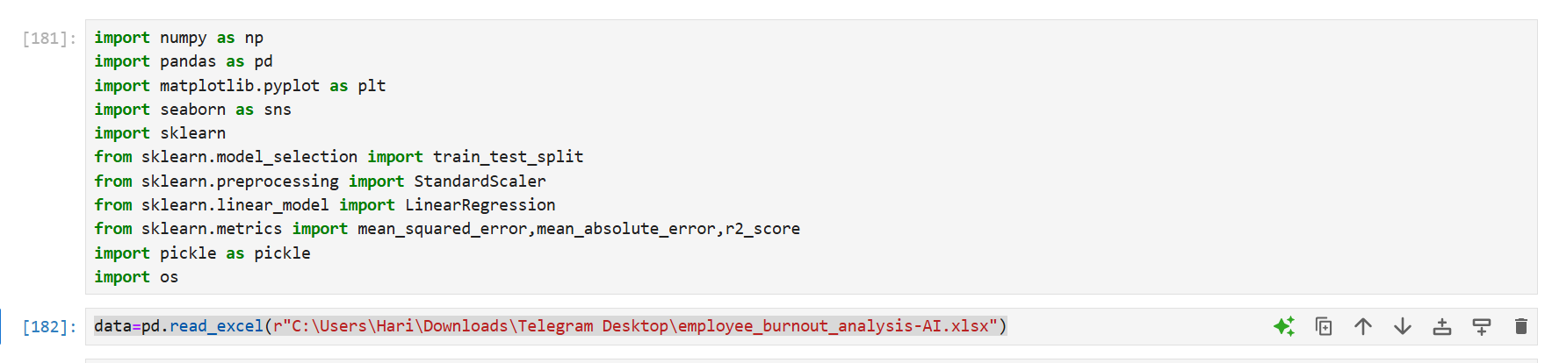
The Libraries used for the project:

Slide 8
Libraries used
NumPy: NumPy (Numerical Python) is a fundamental library for numerical computing in Python. It provides support for arrays, matrices, and a wide range of mathematical functions to operate on these data structures.
Key Features: Efficient array operations, mathematical functions,
Pandas: Pandas is a powerful data manipulation and analysis library. It provides data structures like DataFrames and Series, which make it easy to handle and analyze large datasets.
Key Features: Data cleaning, manipulation, and analysis; handling of missing data; and support for various file formats like CSV, Excel, and SQL databases
Matplotlib: Matplotlib is a plotting library for creating static, interactive, and animated visualizations in Python. It is highly customizable and works well with NumPy and Pandas.
Key Features: Creation of various types of plots such as line graphs, scatter plots
Seaborn: Seaborn is a statistical data visualization library built on top of Matplotlib. It provides a high-level interface for drawing attractive and informative statistical graphics.
Key Features: Built-in themes and color palettes; easy creation of complex visualizations like heatmaps
Scikit-Learn (sklearn):Scikit-Learn is a comprehensive machine learning library that provides simple and efficient tools for data mining and data analysis. It supports various supervised and unsupervised learning algorithms
Key Features: Classification, regression, clustering, dimensionality reduction, model selection, and preprocessing; integration with NumPy and Pandas..
Pickle: Pickle is a module in Python used for serializing and deserializing Python objects. It allows you to save objects to a file and load them back into memory, which is useful for saving machine learning models or other data structures

Slide 9
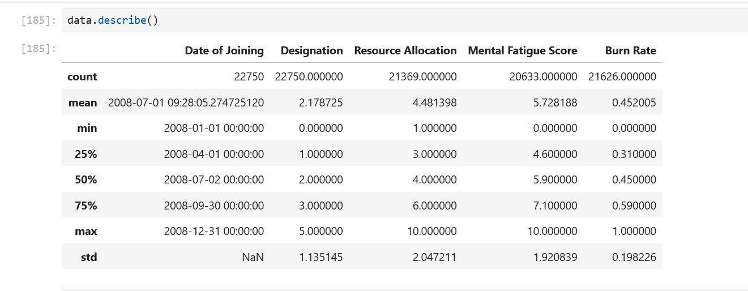
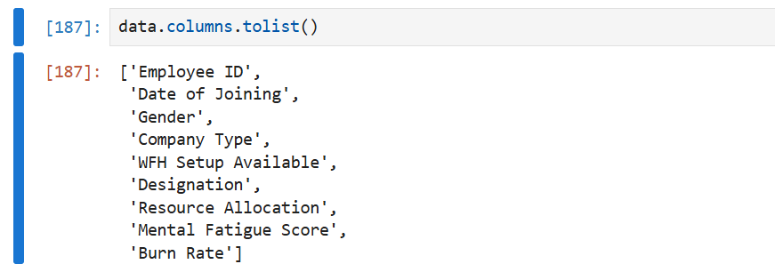
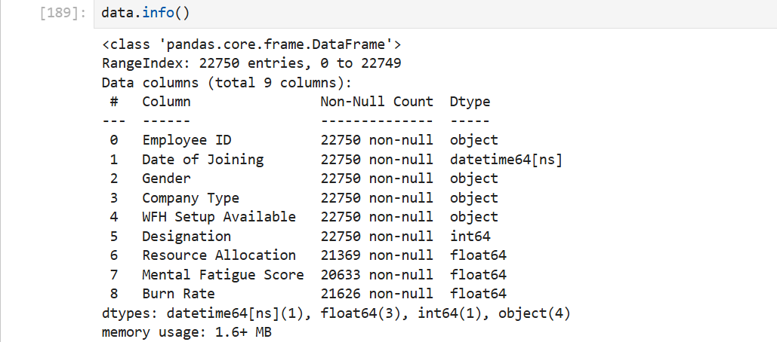
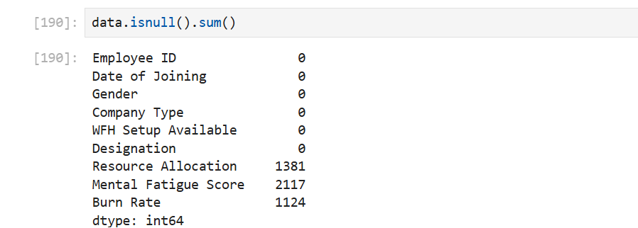
Data set overview:

Slide 10
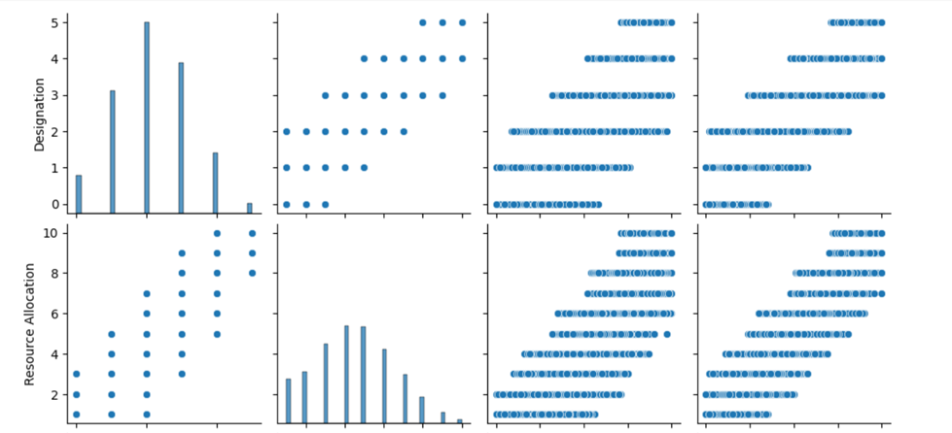
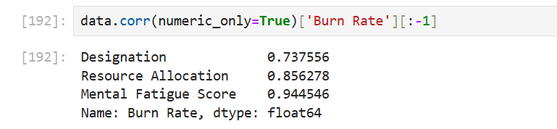
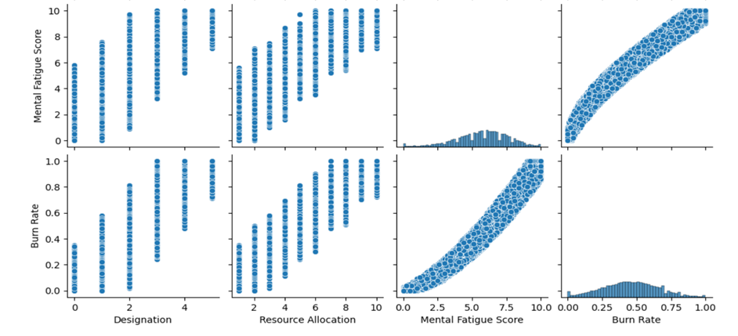
Exploratory Data analysis:
We have found out that Designation, Resource allocation , Mental fatigue scores provide great correlation to the employee burnout rate and so we are going to perform linear regression using these

Slide 11
How did you customize your project and make it your own:
Diverse Model Usage: Implemented multiple machine learning models including Decision Tree Regressor, Gradient Boosting Regressor, AdaBoost Regressor, K-Neighbors Regressor, and others.
Model Comparison: Evaluated each model's performance using comprehensive metrics such as Mean Squared Error (MSE), Root Mean Squared Error (RMSE), Mean Absolute Error (MAE), and R-squared (R²) to identify the best-performing model.
Ensemble Techniques: Explored ensemble methods to combine predictions from different models to improve accuracy and robustness.

Slide 12
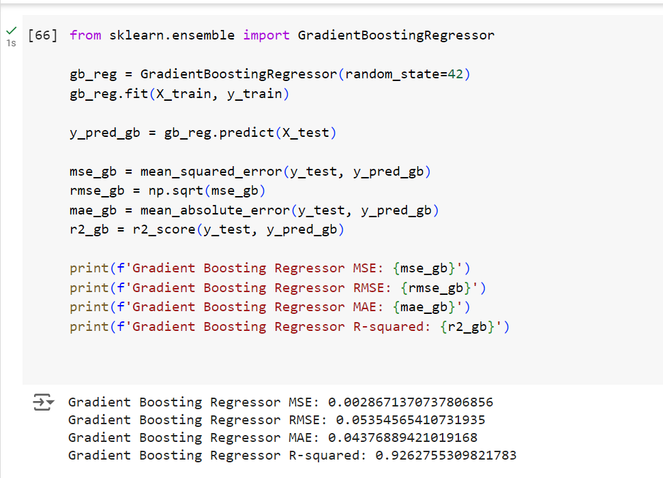
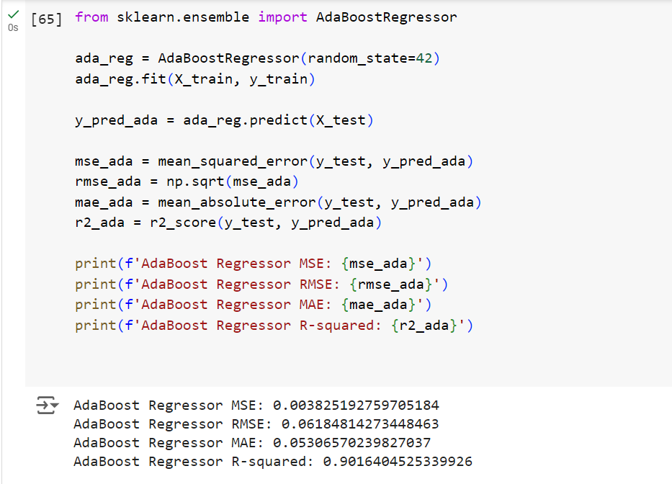
Gradient Boosting Regressor:
ADA Boost Regressor:

Slide 13
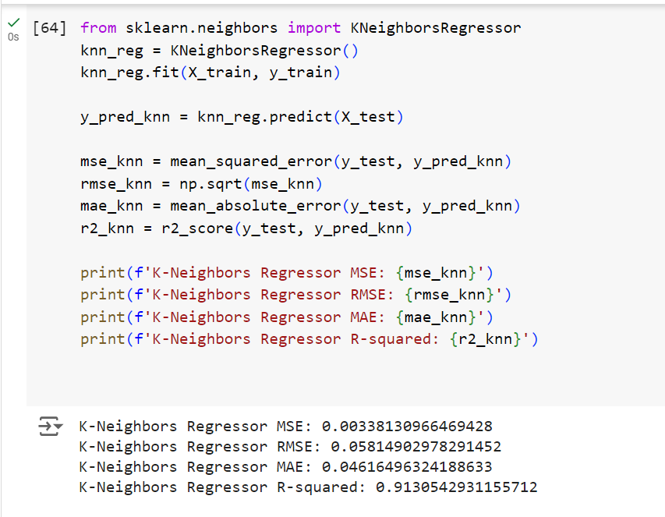
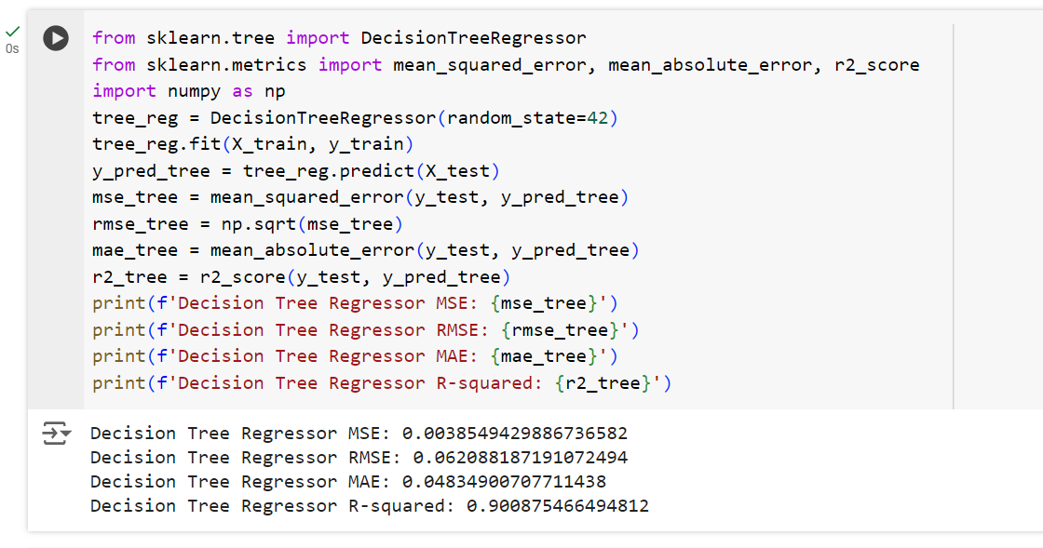
K Neighbors Regressor:
Decision Tree Regressor:

Slide 14
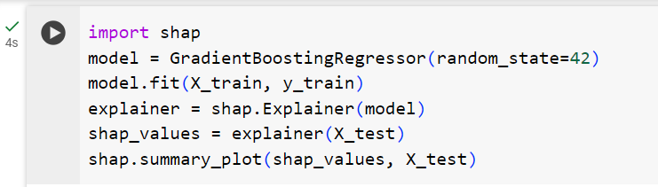
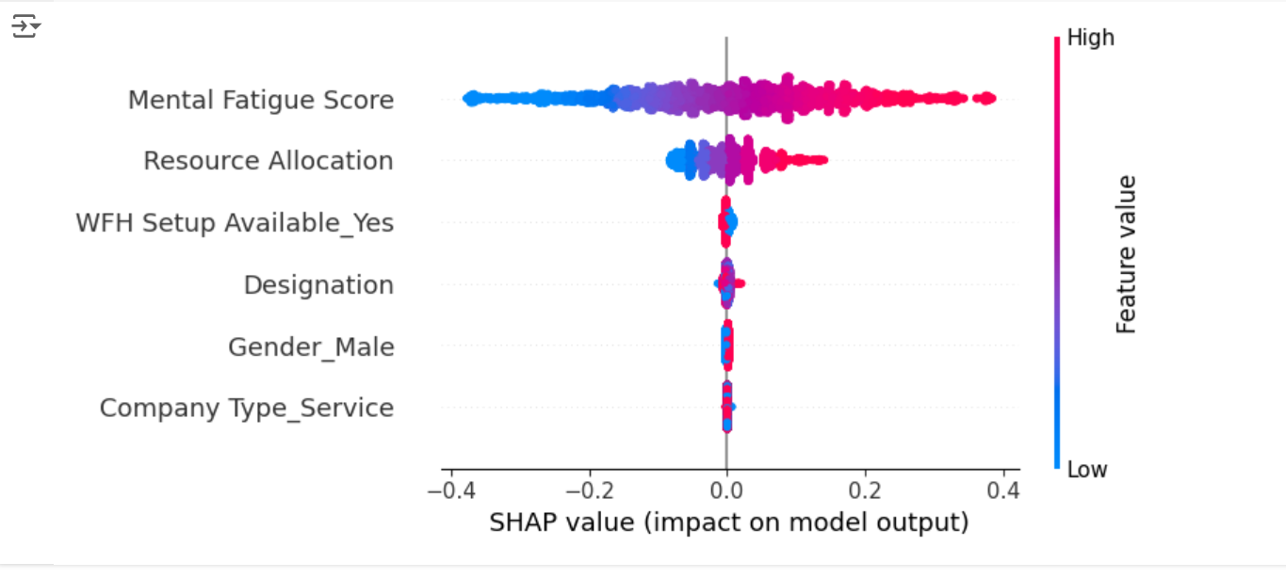
Model Training with SHAP:

Slide 15
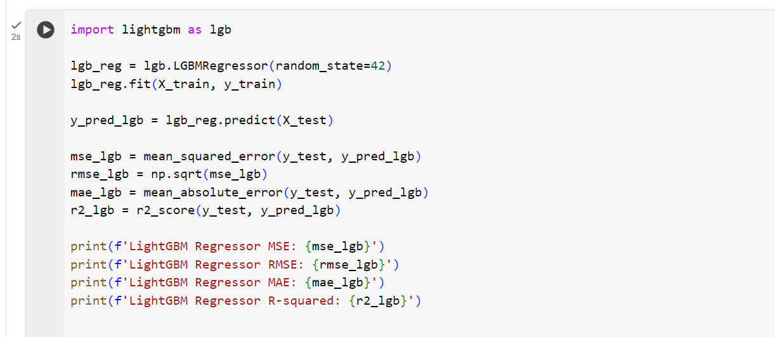
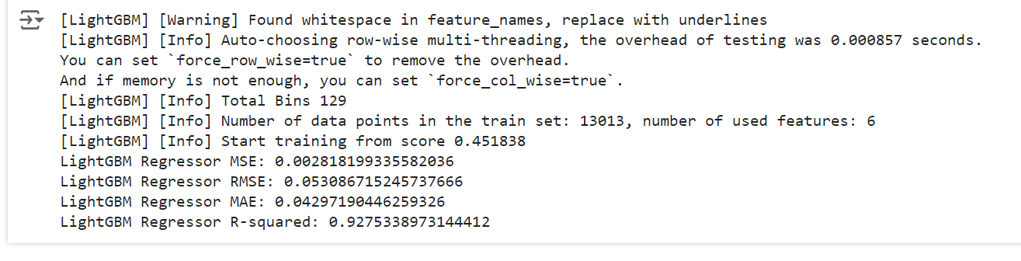
Light GBM Regressor:

Slide 16


Modelling :Linear Regression Model:
Linear regression is a fundamental statistical method used to model the relationship between a dependent variable (what you're trying to predict) and one or more independent variables (what you're using to make the prediction). It's a cornerstone of supervised machine learning and has a wide range of applications.
The goal is to find the line that best captures the overall trend of the data points. This line minimizes the errors between the predicted values and the actual values of the dependent variable.
Prediction: Linear regression can be used to predict the value of the dependent variable based on the values of the independent variables.
Understanding Relationships: It helps to identify and quantify the linear relationships between variables

Slide 17
The formula for linear regression is used to model the relationship between a dependent variable 𝑦y and one or more independent variables 𝑥x. In the case of a single independent variable (simple linear regression), the formula is:
𝑦=𝛽0+𝛽1𝑥+𝜖
where:
y is the dependent variable (the output or target variable).
𝑥 is the independent variable (the input feature).
𝛽0 is the intercept (the value of 𝑦y when 𝑥x is 0).
𝛽1​ is the slope (the change in 𝑦y for a one-unit change in 𝑥x).
𝜖ϵ is the error term (the difference between the predicted value and the actual value).In the case of multiple independent variables (multiple linear regression), the formula generalizes to:
𝑦=𝛽0+𝛽1𝑥1+𝛽2𝑥2+⋯+𝛽𝑝𝑥𝑝+𝜖
where:
𝑥1,𝑥2,…,𝑥𝑝x 1​ ,x 2​ ,…,x p​ are the independent variables (features).
𝛽1,𝛽2,…,𝛽𝑝β 1​ ,β 2​ ,…,β p​ are the coefficients (weights) for each independent variable
.𝛽0β 0​ is the intercept.𝜖ϵ is the error term.

Slide 18
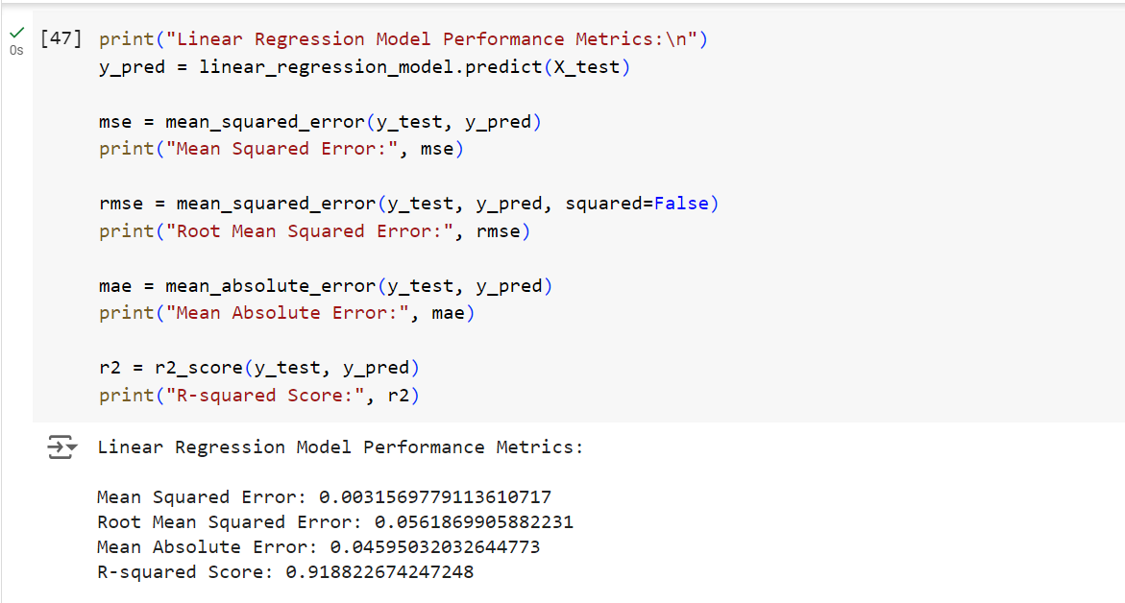
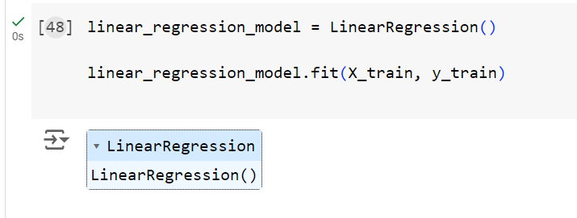
Results
MSE and RMSE: These values suggest that the model's predictions are fairly accurate, with an average squared error of 0.00315 and an average prediction error of 0.0561.
MAE: The model's average absolute prediction error is 0.045, indicating that, on average, predictions are off by this amount.
R-squared (R²): With a value of 0.918, the model explains 91% of the variance in the burnout risk, indicating a strong relationship between the predictors and the target variable.

Slide 19
Conclusion:
The linear regression model successfully predicts employee burnout risk with reasonable accuracy. The insights gained from this model can be used by HR professionals, managers, and organizational leaders to proactively address employee burnout, thereby improving employee well-being, job satisfaction, and overall organizational productivity. This approach also helps in the efficient allocation of resources to support employees most in need, promoting a healthier and more productive work environment.

Slide 20

LINKS:
Link to my project on Google colab:
https://colab.research.google.com/drive/1SReqmEYISZ9BJsjzEYHp5kGwxTyrqyFR?usp=sharing
Link to my GitHub Project:
https://github.com/GopiKHM?tab=repositories
https://github.com/GopiKHM/Employee-Burnout-Prediction
https://colab.research.google.com/
https://jupyter.org/
https://www.ibm.com/docs/en/db2oc?topic=procedures-linear-regression

Slide 21
Thank you

